Slide 1



Slide 2

BUSINESS ANALYTICS Introduction to Business Analytics and Core Business Functions
BUSINESS ANALYSIS Introduction to Analytics

Slide 3
Learning Objectives – WEEK 9
By the end of today you should be able to:
Understand different types of analytics
Differentiate descriptive, diagnostic, predictive, and prescriptive analytics
Connect analytics with business decisions
Translate business problems into analytical questions
Data doesn’t create value — decisions based on data do.

Slide 4
Previous Week - 8
Last week we improved processes:
✔ Root Cause Analysis ✔ Bottleneck identification ✔ Gap analysis
Now:
👉 Analytics helps us measure and validate those improvements.
Data doesn’t create value — decisions based on data do.

Slide 5
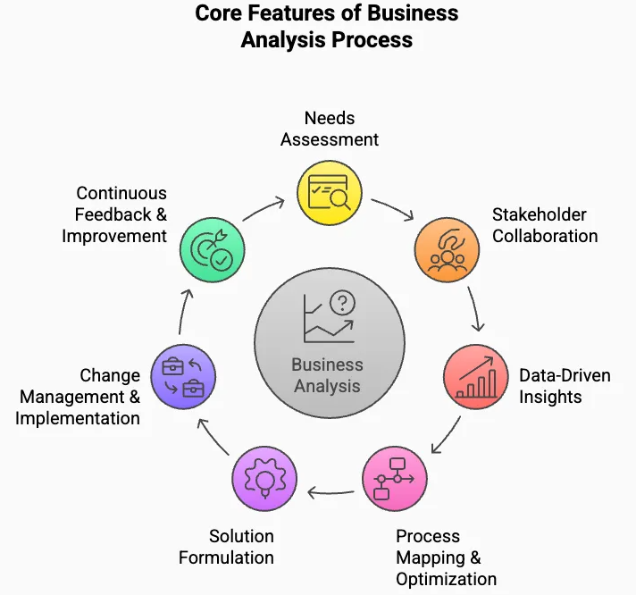
WHAT IS ANALYTICS?
Analytics = using data to understand and improve business decisions.
🇵🇰 Pakistan Example
Daraz tracks:
Orders per day
Delivery time
Customer ratings
Uses data to improve operations.
🌎 International Example
Netflix tracks:
What you watch
When you stop watching
What you like
Uses data to recommend content.
👉 “Is Excel sheet analytics?”
Analytics = insight + decision-making, not just data storage.
Data → Insight → Decision

Slide 6
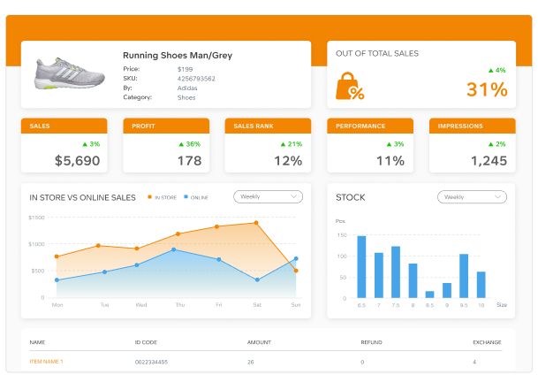
TYPES OF ANALYTICS
Descriptive → Diagnostic → Predictive → Prescriptive
📊 1. Descriptive Analytics (WHAT happened?)
Explain:
Descriptive = summary of past data.
Examples
Pakistan:
Foodpanda report:
Orders this week = 10,000
Avg delivery time = 35 mins
International:
Spotify:
Most played song
User listening hours
👉 “How many hours did you use your phone yesterday?”
Descriptive = “Report”

Slide 7
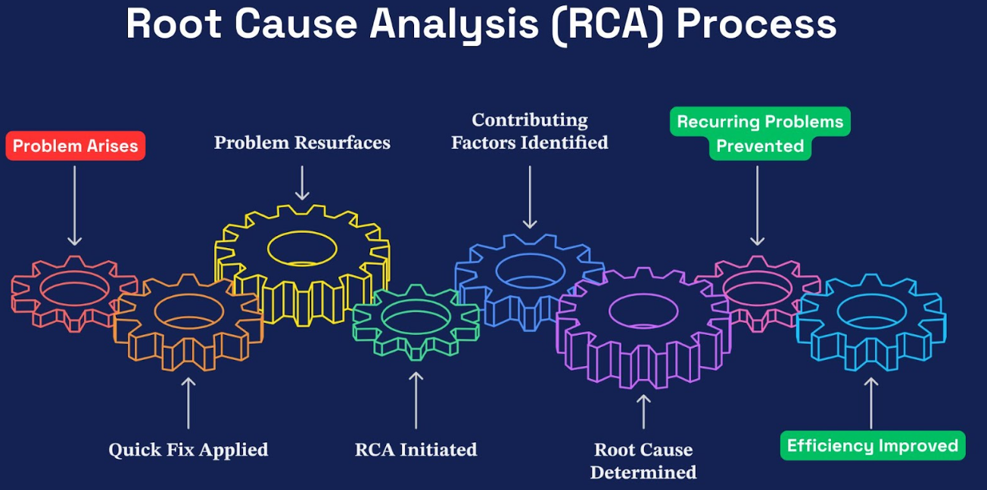
TYPES OF ANALYTICS
🔍 2. Diagnostic Analytics (WHY it happened?)
Explain:
Diagnostic = finding reasons behind data.
🇵🇰 Example
Daraz sales drop:
Reason:
Discount ended
Delivery delay increased
🌎 Example
Netflix users leaving:
Reason:
Poor recommendations.
👉 “Why do students fail exams?”
Diagnostic = “Investigation”

Slide 8
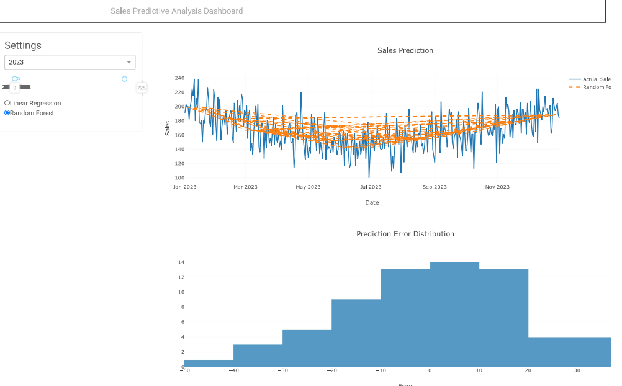
TYPES OF ANALYTICS
🔮 3. Predictive Analytics (WHAT will happen?)
Explain:
Predictive = forecasting future using data.
🇵🇰 Example
Bank predicts:
Which customers may default on loans.
🌎 Example
Amazon predicts:
What you might buy next.
👉 “Will food delivery orders increase on weekends?”
Predictive = “Forecast”

Slide 9
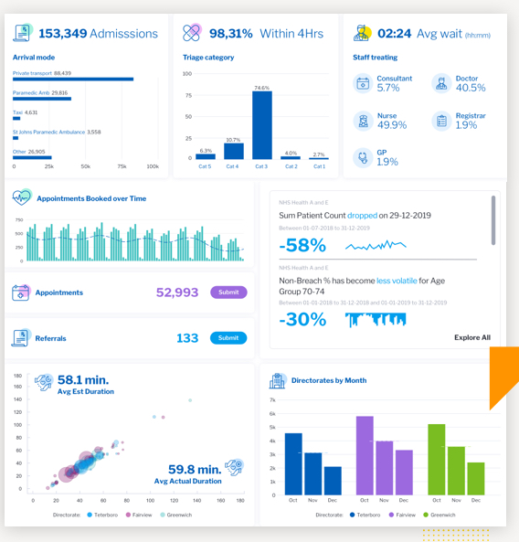
TYPES OF ANALYTICS
🎯 4. Prescriptive Analytics (WHAT should we do?)
Explain:
Prescriptive = recommends actions.
🇵🇰 Example
Ride-hailing app suggests:
Increase prices during peak hours.
🌎 Example
Google Maps suggests:
Best route to avoid traffic.
Prescriptive = “Decision”

Slide 10
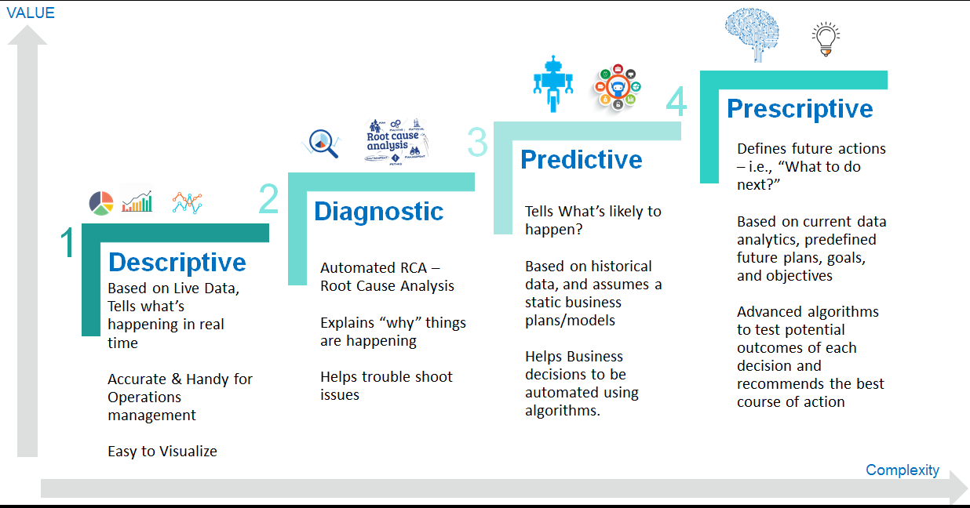
VISUAL PYRAMID

Slide 11
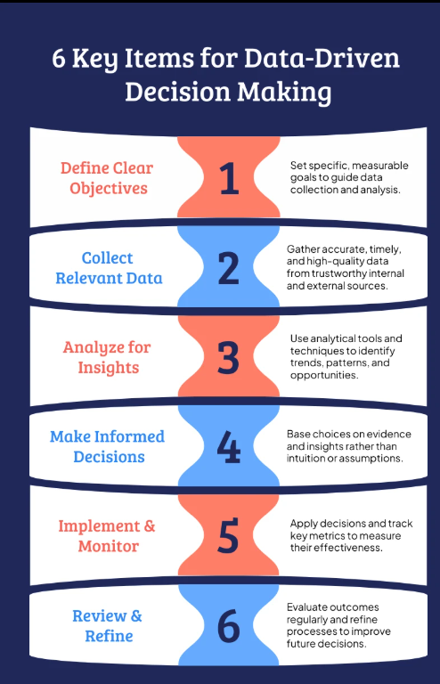
BUSINESS VS ANALYTICAL QUESTIONS
Explain:
Business question is vague. Analytical question is measurable.
Example
Business Question:
👉 “Why are sales low?”
Analytical Question:
👉 “What factors caused a 20% drop in sales last month?”
Business: “Why are Careem rides decreasing?”
Analytical: “What is average wait time vs cancellations?”

Slide 12
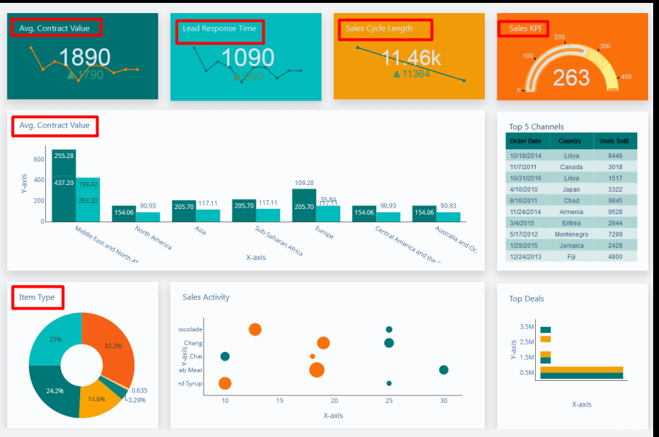
METRICS & DATA (FOUNDATION FOR WEEK 10)
Explain:
Analytics depends on metrics.
Examples:
✔ Revenue ✔ Conversion rate ✔ Delivery time ✔ User retention
Bad metric = wrong decision.

Slide 13
CASE STUDY
Scenario:
University LMS usage dropping.
Students must:
✔ Identify descriptive data ✔ Ask diagnostic questions ✔ Predict future ✔ Suggest actions
Connecting Dots
Scenario:
QuickBasket deliveries slow.
Descriptive
Avg delivery time = 50 mins.
Diagnostic
Reason:
Manual rider assignment.
Predictive
Peak hour delays expected.
Prescriptive
Introduce automated dispatch.

Slide 14
COMMON MISTAKES STUDENTS MAKE
❌ Confusing descriptive with diagnostic ❌ Jumping to solutions without data ❌ Using assumptions instead of analysis
Always move step by step.

Slide 15
ROLE OF BUSINESS ANALYST IN ANALYTICS
BA responsibilities:
✔ Define analytical questions ✔ Identify metrics ✔ Interpret results ✔ Communicate insights
BA is NOT data scientist.
BA = bridge between business and data.

Slide 16
KEY TAKEAWAYS (END OF LECTURE)
✔ Descriptive = What happened ✔ Diagnostic = Why it happened ✔ Predictive = What will happen ✔ Prescriptive = What to do
✔ Analytics drives business decisions ✔ Business Analysts convert business problems into data questions

